Slide 1
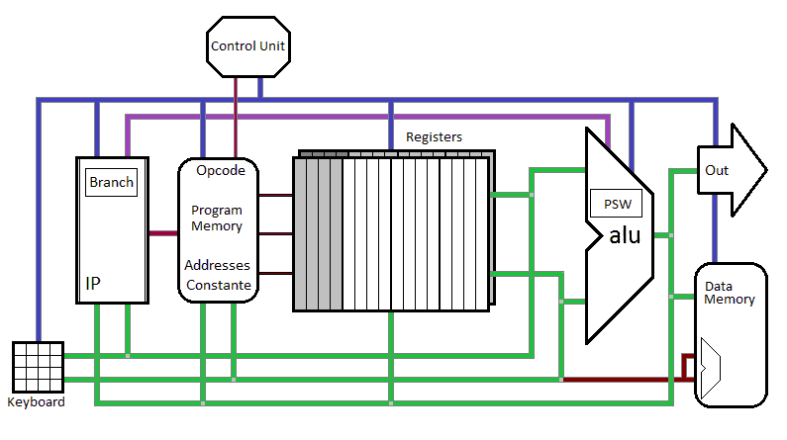

Slide 2
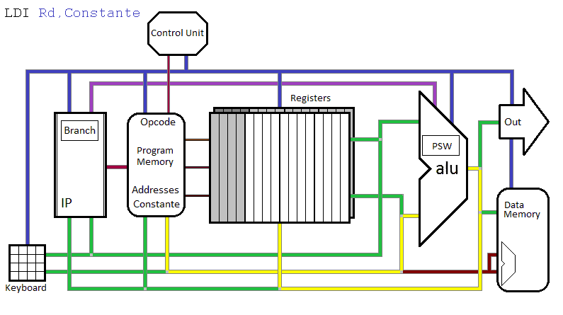
IP sends address of instruction to Program Memory. PM sends opcode to
Control Unit, and adresses a destination Register. CU enables output of PM, controls the ALU. and enables Parallel Loading of Addressed Register.
(See the yellow route)

Slide 3
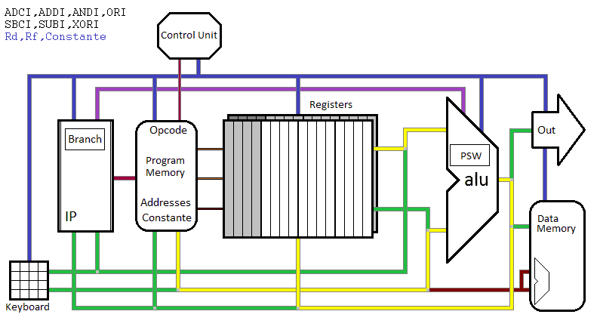
IP sends address of instruction to PM. PM adresses a destination Register and a source Register. PM sends opcode to CU. CU enables output of PM,
controls the ALU. The result of the operation on Rf and constante will be placed in Rd

Slide 4
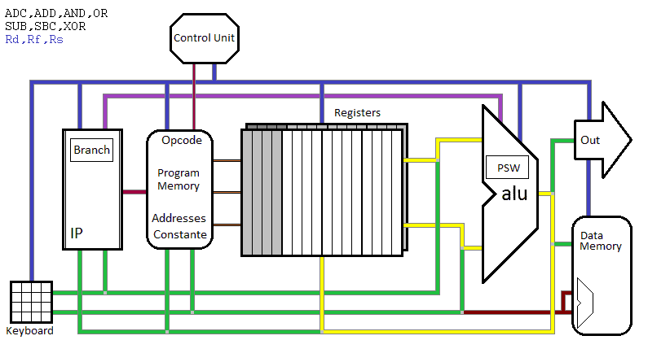
IP sends address of instruction to PM. PM adresses a destination Register and two source Registers. PM sends opcode to CU. CU enables output of both source Registers, controls the ALU. The result of the operation on Rf and Rs will be placed in Rd (Rf is first operand, Rs is second operand)

Slide 5
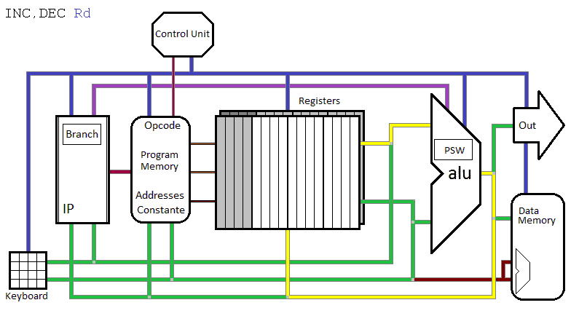
IP sends address of instruction to PM. PM adresses a destination Register and the same Register as source. PM sends opcode to CU. CU enables output of source Registers, controls the ALU. The result will be placed in Rd

Slide 6
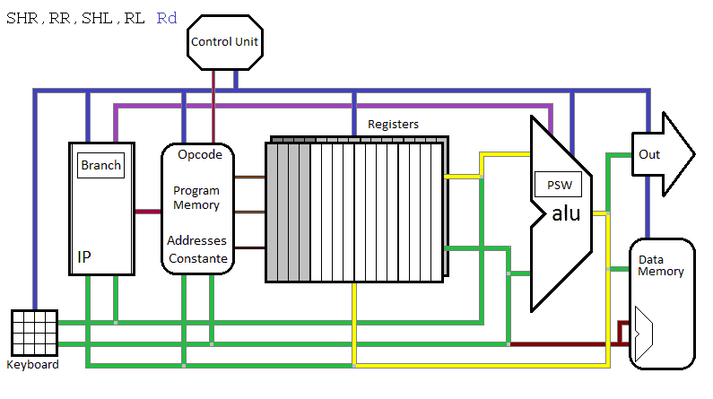
IP sends address of instruction to PM. PM adresses a destination Register and the same Register as source. PM sends opcode to CU. CU enables output of source Registers, controls the ALU. The result will be placed in Rd
(SHR & RR: lsb goes to Carry. SHL & RL: msb goes to Carry. RR: Cy goes to msb.
RL: Cy goes to lsb.

Slide 7
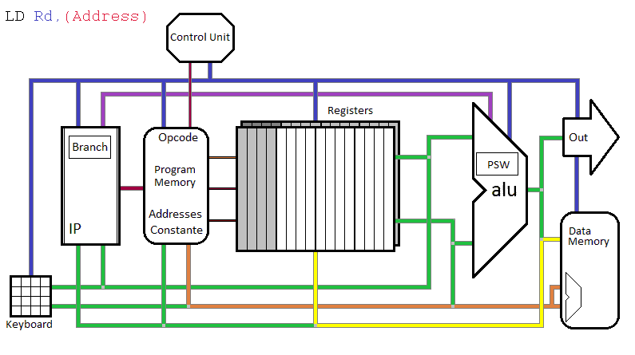
IP sends address of instruction to PM. PM adresses a destination Register.
PM sends opcode to CU. CU enables output of PM, which now delivers the address of a location in Data Memory. The contents of this location goes to Rd

Slide 8
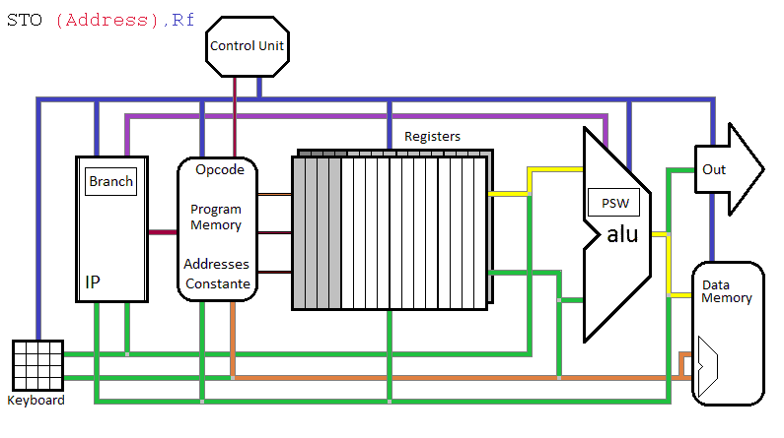
IP sends address of instruction to PM. PM adresses a source Register.
PM sends opcode to CU. CU enables output of PM, which now delivers the address of a location in Data Memory. The contents of Rf will be placed in the
addressed memory location

Slide 9
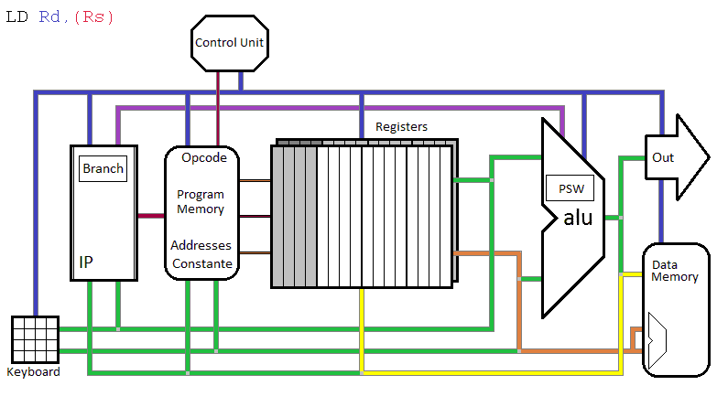
IP sends address of instruction to PM. PM adresses a destination Register and an address- Register. PM sends opcode to CU. CU enables output of address-
Register (Second Operand) , which now delivers the address of a location in Data Memory. The contents of this Memory location will be placed in destination Register

Slide 10
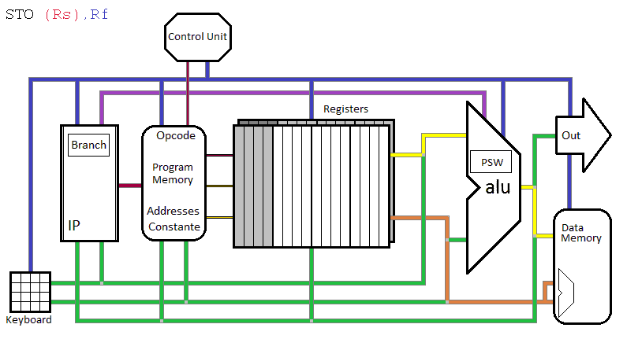
IP sends address of instruction to PM. PM adresses a source Register and an address-Register. PM sends opcode to CU. CU enables output of address-
Register (Second Operand) , which now delivers the address of a location in Data Memory. The contents of the Source Register (First Operand) will be placed in the adressed Memory location.

Slide 11
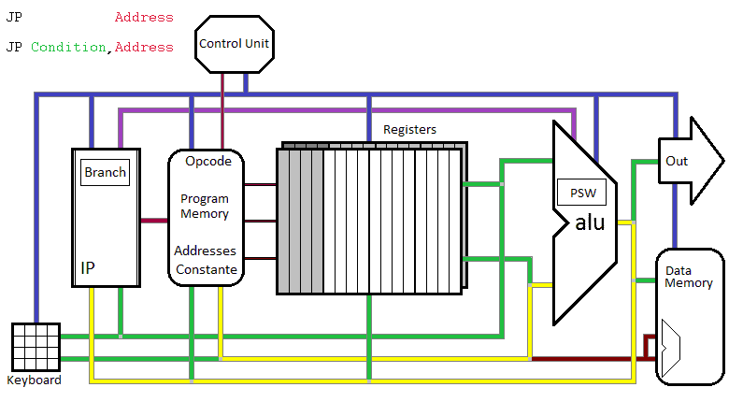
IP sends address of instruction to PM. PM sends opcode to CU. CU enables output of PM , which now delivers the address of the new instruction. This address is loaded into IP. Loading IP (Instruction Pointer) depends on
conditions in the condition Register (Sign, Zero, Overflow, Carry), or on the inverse of these conditions.

Slide 12
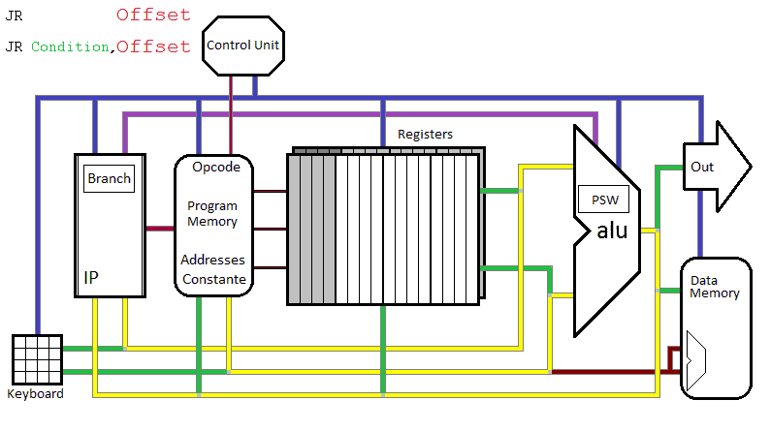
IP sends address of instruction to PM. PM sends opcode to CU. CU enables output of PM , which now is added to the old value of IP. This new address is an offset to the old address. Loading IP (Instruction Pointer) depends on conditions in the condition Register (Sign, Zero, Overflow, Carry), or on the inverse of these conditions.

Slide 13
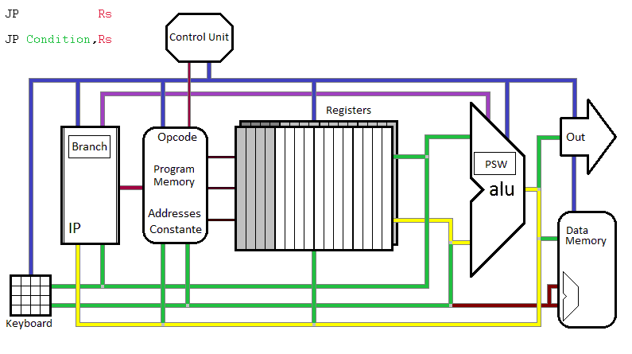
IP sends address of instruction to PM. PM sends opcode to CU. CU enables a source Register, which value will be loaded in IP. Loading IP
(Instruction Pointer) depends on conditions in the condition Register
(Sign, Zero, Overflow, Carry), or on the inverse of these conditions.

Slide 14
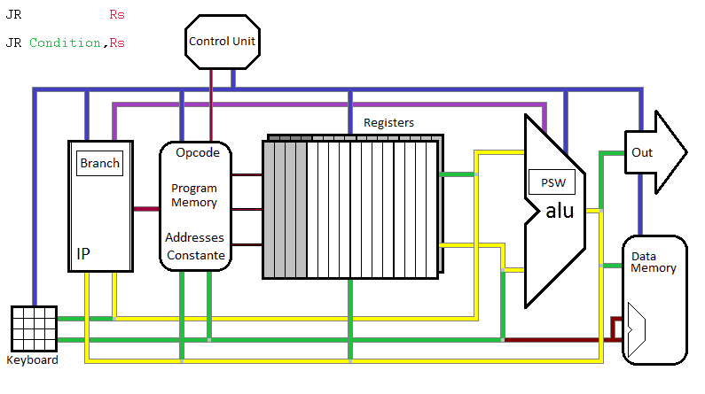
IP sends address of instruction to PM. PM sends opcode to CU. CU enables a source Register, which value is now added to the old value of IP. This new address is an offset to the old address. Loading IP(Instruction Pointer) depends on conditions in the condition Register (Sign, Zero, Overflow, Carry), or on the inverse of these conditions.

Slide 15
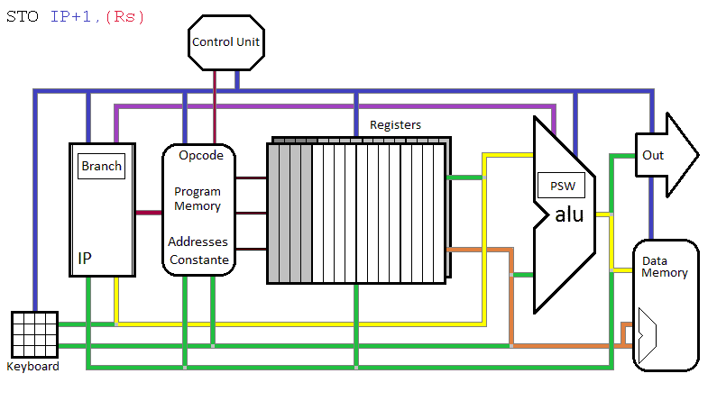
IP sends address of instruction to PM. PM sends opcode to CU. CU enables a source Register (Stack Pointer), this register points to the Memory Location, into which the value of (PC+1) is saved. CU controls the ALU.

Slide 16
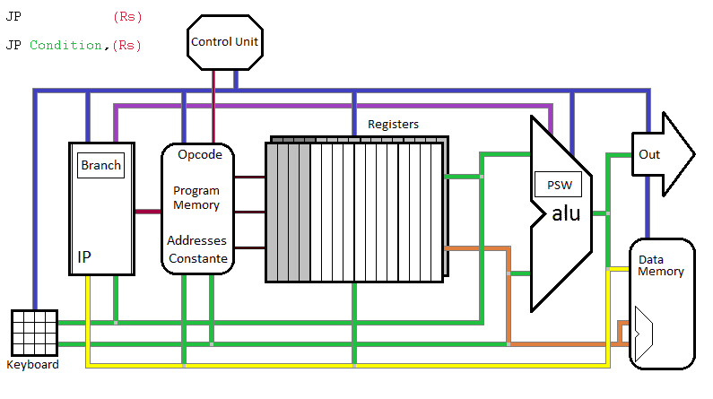
IP sends address of instruction to PM. PM sends opcode to CU. CU enables a source Register (Stack Pointer).
Rs contains the address of the memory location, which contents will be loaded into IP.

Slide 17
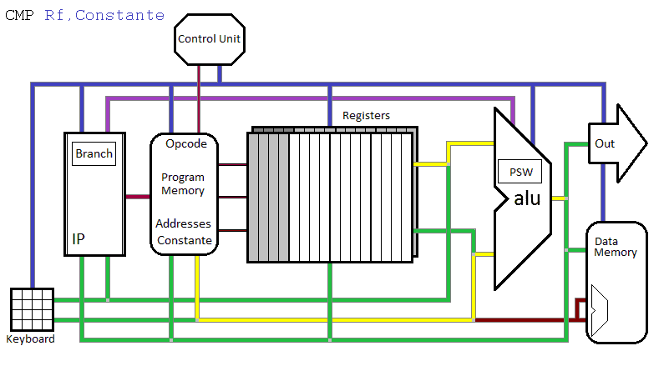
IP sends address of instruction to PM. PM sends opcode to CU.
CU controls the ALU. CU enables Rf and PM. The value in PM is subtracted from Rf. Conditon-flags are affected according to the result. This result will not be saved anywhere. A jump, jump relative and so, on will whether or not be executed, depending on the condition.

Slide 18
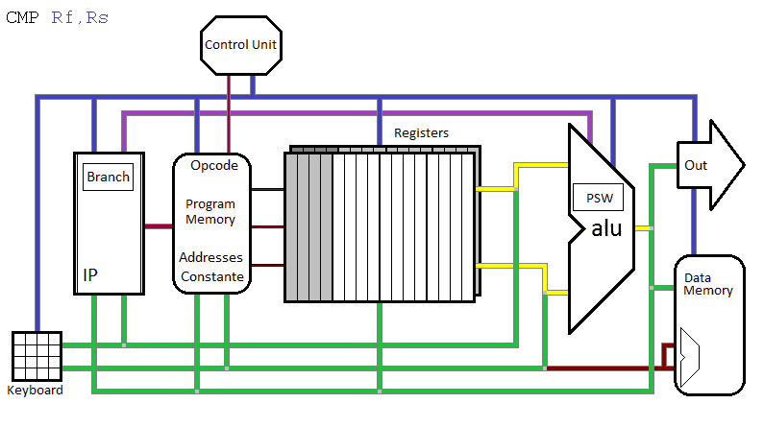
IP sends address of instruction to PM. PM sends opcode to CU.
CU controls the ALU. CU enables Rf and Rs. Rs is subtracted from Rf.
Conditon-flags are affected according to the result. This result will not be saved
anywhere. A jump, jump relative and so on, will whether or not be executed, depending on the condition.

